Slide 1

Presented By:
Saanvi Mohan
Swasti Singhal
Dishee Jain
Trishad Bisawa
Sanskriti Goyal
Vartika Agrawal

Slide 2

Introduction
“Black” , a film based on Helen Keller, follows the journey of a deaf and blind girl Michelle McNally, and her struggles to survive and find a place in the world and Debraj Sahai, eccentric and peculiar man who , once Michelle's teacher and helped pull her out of the dark place and brought light in her “black” life, now suffers from Alzheimer's.
The film depicts their struggles , challenges, emotions and the triumphs as they form a bond that lasts a lifetime.
In this presentation we dive deep and dissect the movie and analyse the psychological themes employed.

Slide 3

Theme #01
Learning
The relatively permanent change in a person’s knowledge or behavior due to experience”

Slide 4
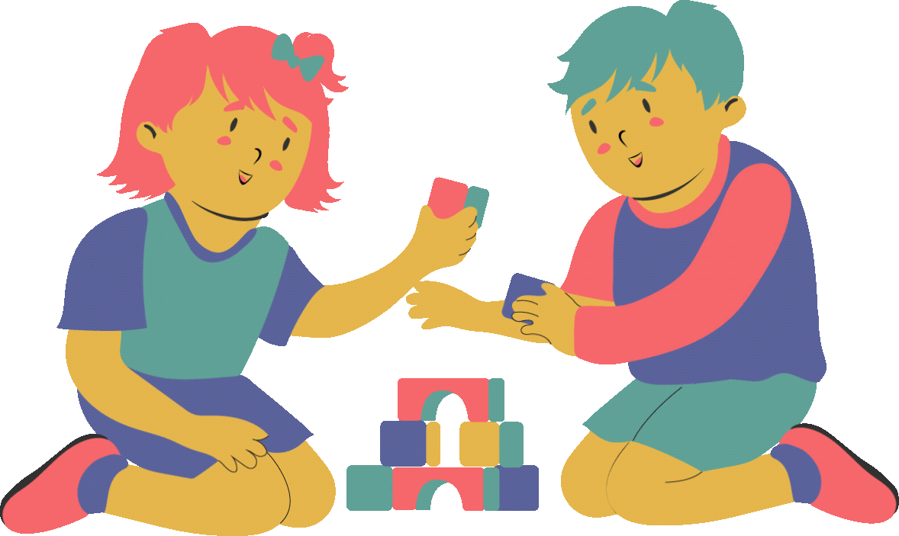
Primary Stages of Learning
The learning process for a normal child is pretty straightforward and natural.
Learning by association
Learning by consequences
Learning by observation
An experience/stimuli occurs. The child is taught how to handle the situations which shapes their mind. The child retains and remembers the experience.
Socialising also plays a huge role in creating and modifying a child's schema in the later stages of development

Slide 5


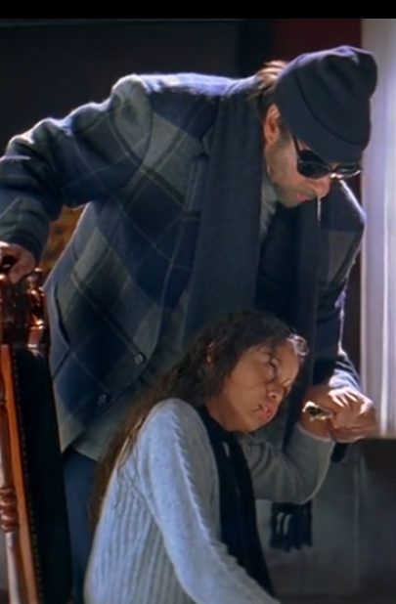
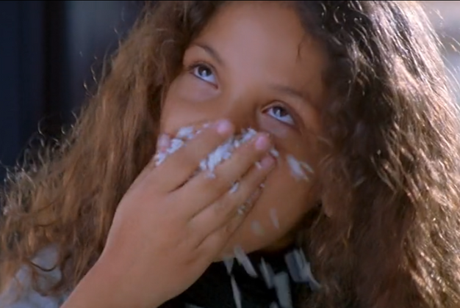
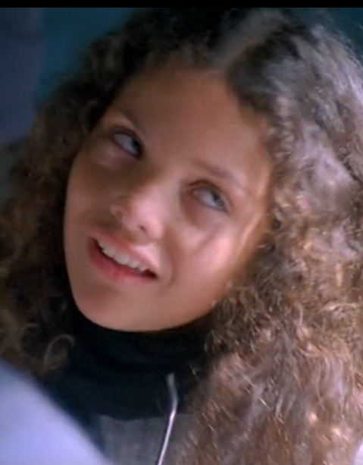
BUT WHAT ABOUT MICHELLE?
Michelle's fear of water is indeed a result of classical conditioning and Debraj helps her overcome it through counterconditioning.
Debraj utilizes operant conditioning by rewarding positive responses with praises.
She closely observes how debraj interacts with the world, with his facial expressions, body language, and use of sign language.

Slide 6
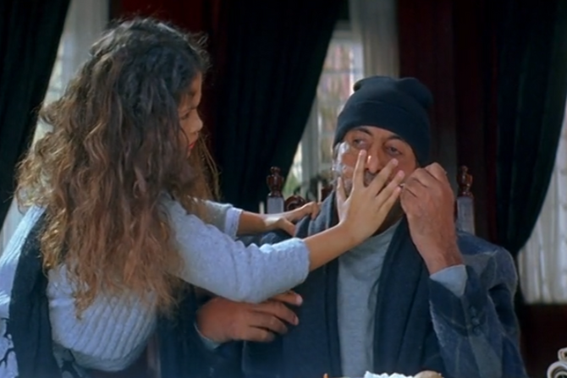
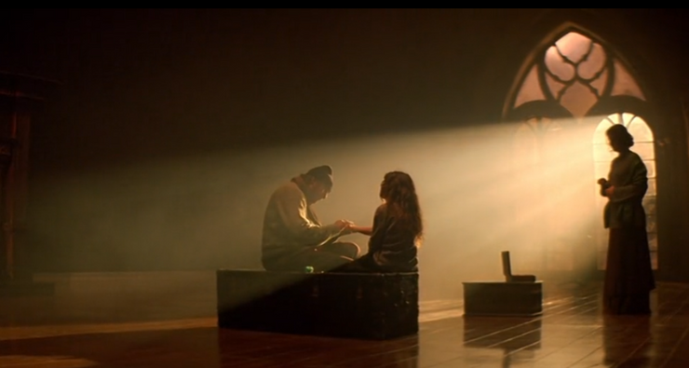
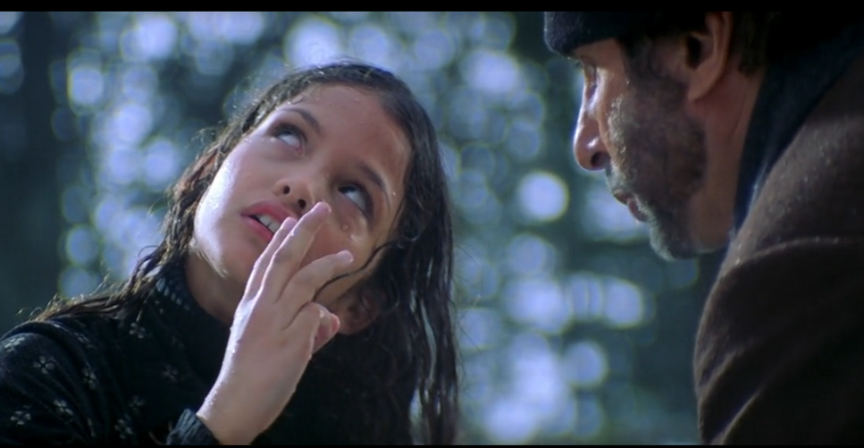

COME INTO THE……
LIGHT
“Andhere me aankhe bhi kisi kaam ki nahi hoti”
A beacon of hope, Mr Debraj Sahai.
Use of punishment and discipline to break through her barriers.
Acted as positive reinforcement throughout Michelle’s life.
Always motivated her and never let her feel that she is handicapped

Slide 7
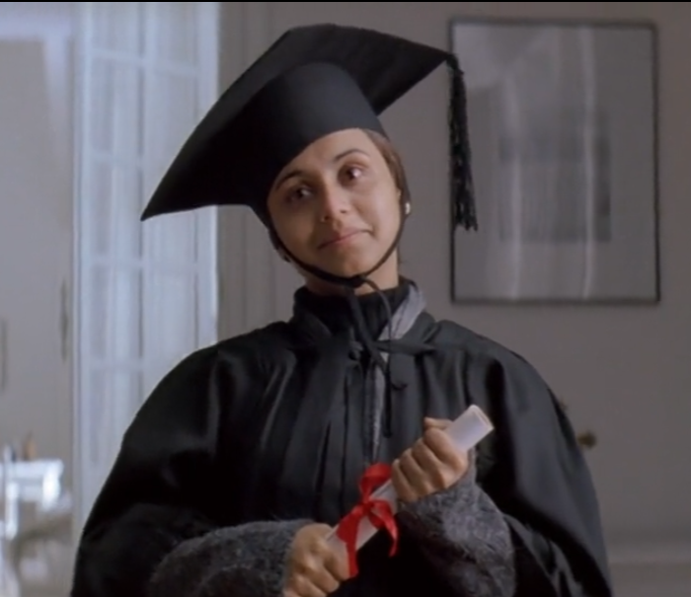
Theme #02
Motivation
Motivation is the willingness to do something and is conditioned by this action’s ability to satisfy some need for the individual.

Slide 8
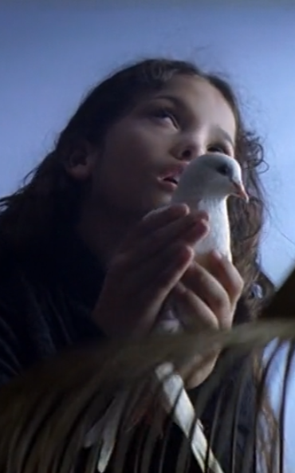
Why was the motivation required?
The cathartic tale of a young woman who can't see, hear, or speak, and the teacher who brings a ray of light into her dark world.
There are so many obstacles, the world has no patience for disabled people, and her teacher's mental condition is deteriorating, but Michelle pursues her goal and narrates her story of victory achieved in spite of all hindrances

Slide 9
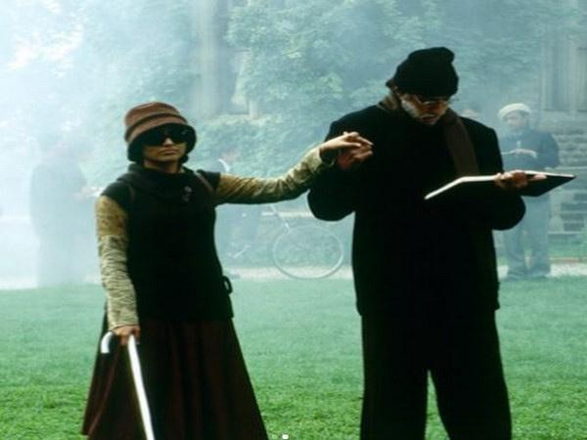


Intrinsic Motivation
Debraj Sahai’s initial motivation to take on Michelle's education and his passion for teaching.
Michelle's motivation to learn and communicate
The intrinsic motivation derived from personal growth.
Debraj's emotional connection to Michelle is a powerful intrinsic motivator.

Slide 10
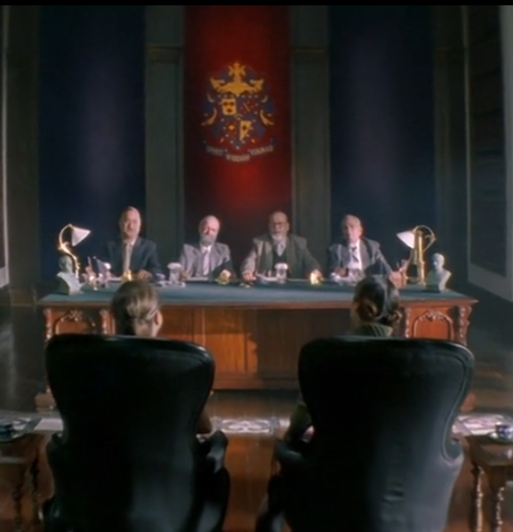

Extrinsic Motivation
External validation and praise from her teacher and the world
Michelle’s and Debraj’s dream to see her graduate.
The external influence of societal expectations

Slide 11



What if there was no Motivation involved?

Slide 12

03
Cognition
mental processes involved in gaining knowledge and comprehension”

Slide 13
Cognitive Model
INPUT
in the environment
Mediational
Processes
Mental Event
Output
Behaviour

Slide 14

Stages of Michelle’s Cognitive Development
Sensorimotor
Pre-operational
Hindered development of sensorimotor intelligence.
Left in the state of black silence
Michelle imitates Debraj without understanding the “WHY” and “WHAT”
She is still unable to associate any meaning to objects and has no concept of language or symbols.
Enter Debjraj Sahai.
Michelle’s breakthrough movement - “Woah tah”
manual alphabet helped her access the world of language and culture
She also has developed her method of learning to say basic sounds by feeling and imitating the lip movements of others.

Slide 15


Stages of Michelle’s Cognitive Development
Concrete operational
Formal operational
Continues steadily in her education
Developed has a sense of empathy
Now understands that words have meanings.
Learns Braille
Enters this stage as she enters college
Makes friends and learns about the world
develops abstract logic and thinking , like the concept of marriage, love, respect.
Graduates with Bachelor of Arts aged 40

Slide 16
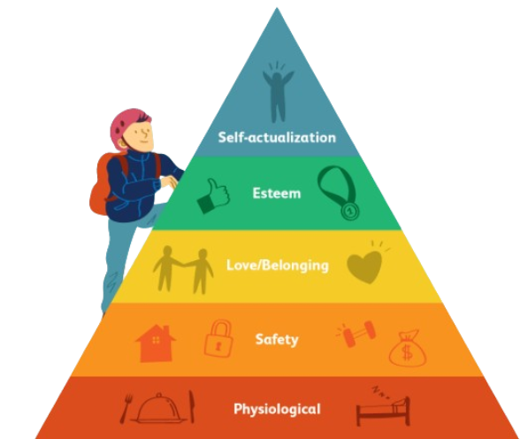
Theme #04
Maslow's Hierarchy
The five categories of human needs dictate an individual's behavior.

Slide 17

Physiological Needs
“Insaan ke roop me jaanwar thi mai, baccho ko satane me badi khushi milti, shayad bhagwaan ko bhi milti hogi”
Michelle
Michelle struggles with her basic physiological needs due to her disabilities.
Challenging for her to fulfill basic needs like hunger, communication, and bodily comfort.

Slide 18
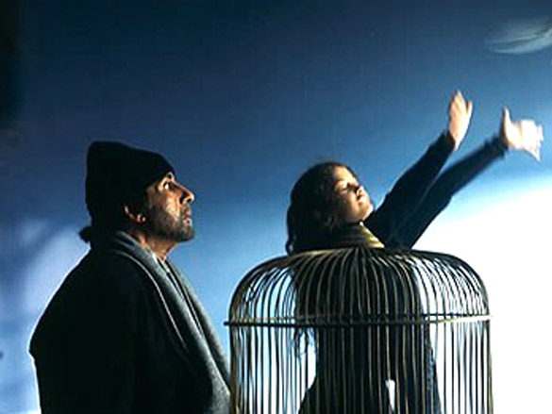
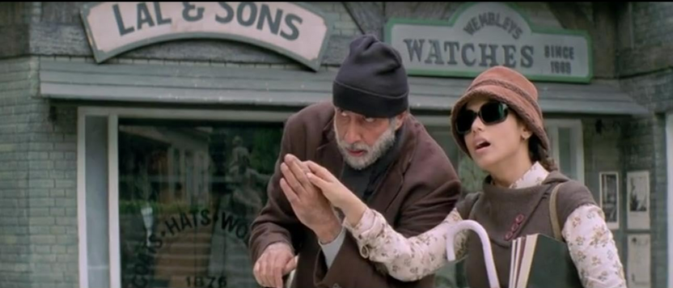
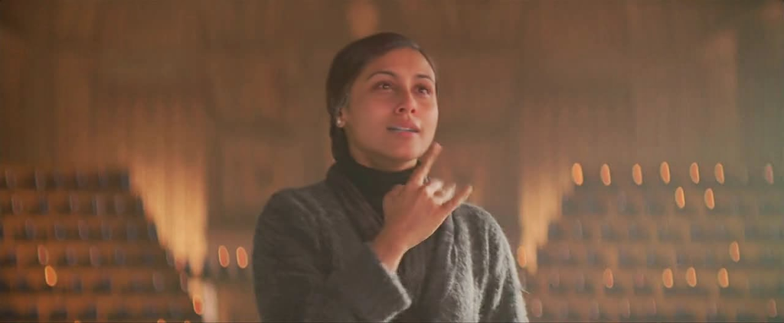
Safety Needs
1
2
3
Debraj took on the responsibility of ensuring Michelle's safety since an early age.
Taught her ways to navigate her surroundings and communicate.
By doing so , ensured that she could take care of her own safety when he’s not present with her.

Slide 19
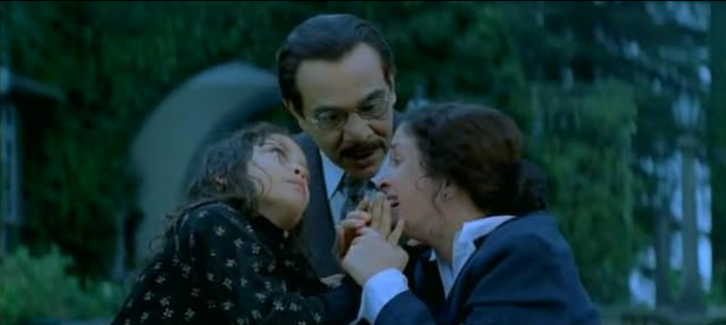
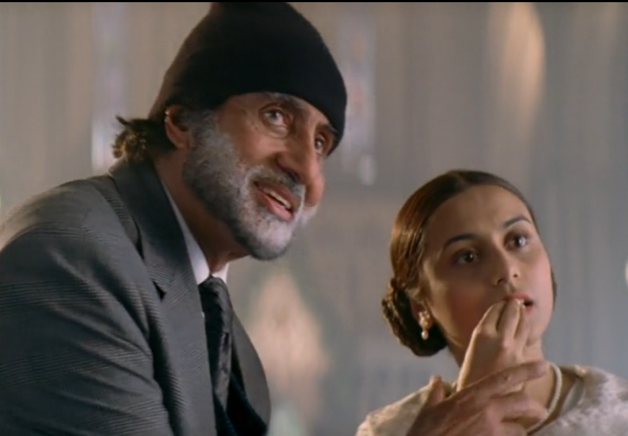
Love and belonging Needs
Michelle’s relationship with her mother
Her mother being her primary caregiver
How the presence of Debraj completed her needs.
Her sister’s marriage and unsettling realisation.

Slide 20
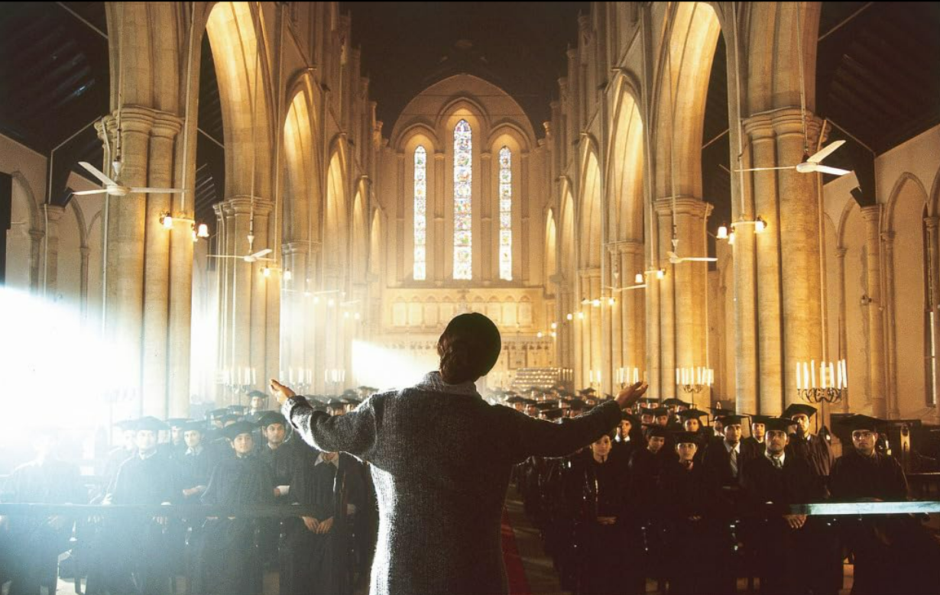


Esteem Needs
She learns to communicate and express herself, which boosts her self-esteem.
The recognition she receives from her family and society
Educational breakthroughs.
Debraj’s low self esteem after not getting proper recognition

Slide 21
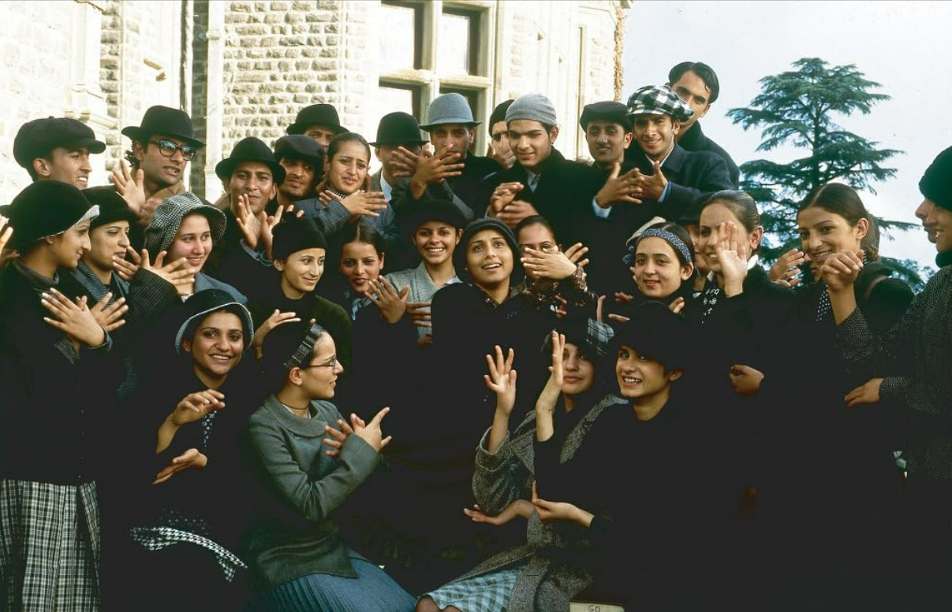
Self Actualisation
Independence and authority over her life.
Breaking societal stereotype.
Impact on others
Debraj’s feeling of contentment

Slide 22
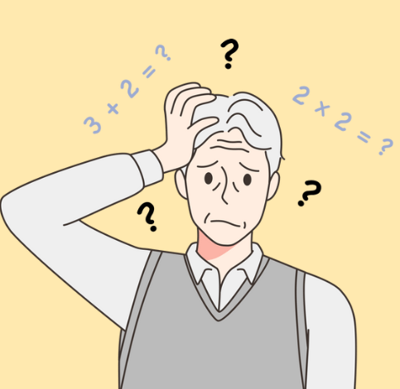
05
Memory
Memory in psychology refers to the cognitive process of encoding, storing, and retrieving information over time. “

Slide 23

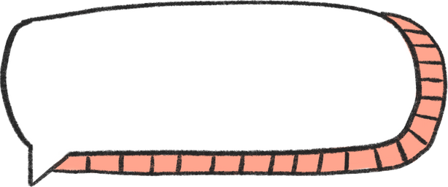

Sensory Memory
Michelle became blind and deaf at the age of two. She lives in a world of darkness and silence, unable to perceive or remember any sensory stimuli.
Sensory-->Senses are they similar
Touch
Smell and Taste
Recognition through touch
Visual Impression through Touch

Slide 24
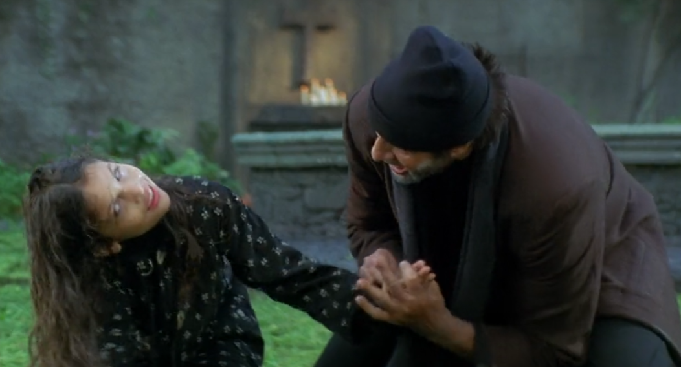
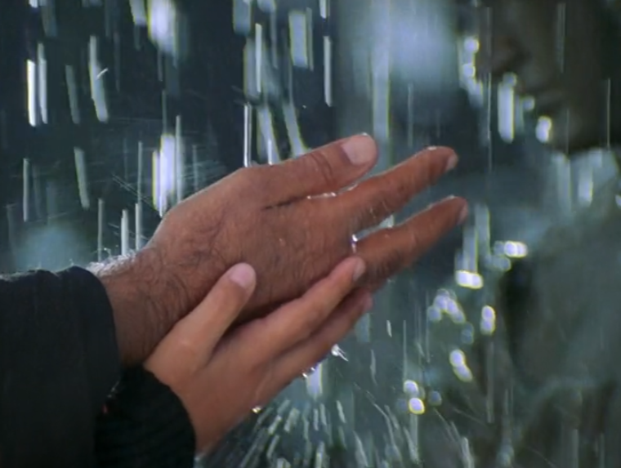
Short Term Memory
Michelle does not have the opportunity to develop a proper short term memory initially.
No concept of language or communication.
Debraj slowly and steadily makes her learn and memorize words and meanings using repetition and rehearsal.

Slide 25
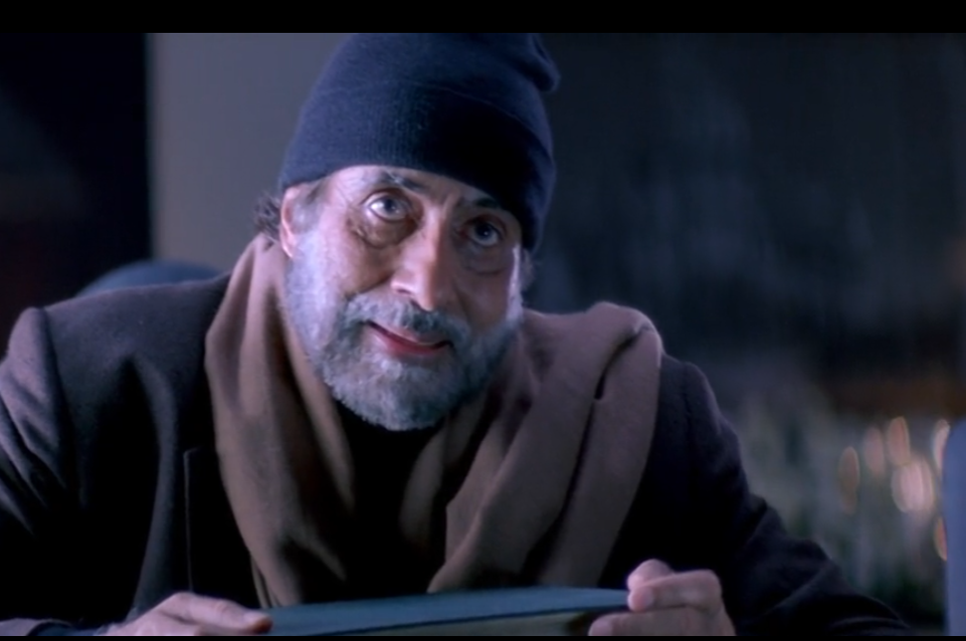
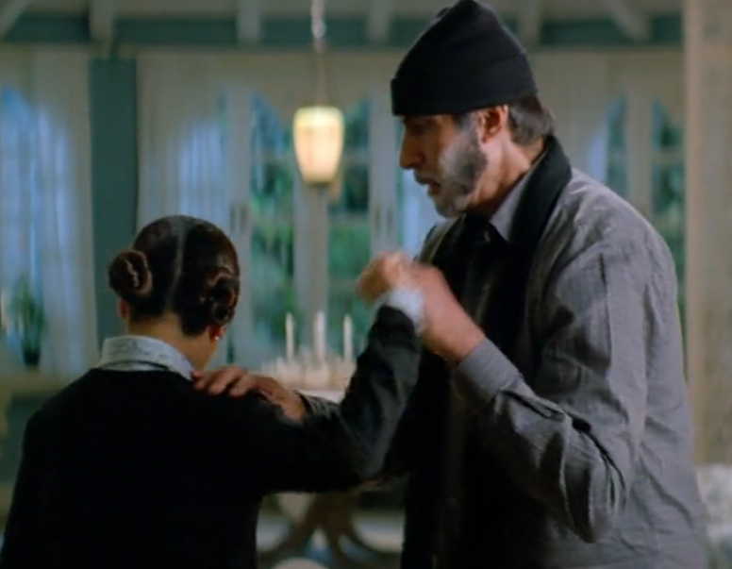
Debraj’s Case
Debraj suffers from Alzheimers in his old age which also hampers his short term memory. He starts forgetting recent event and people he has met.
Example from movie
Example from movie
Debraj forgets which way he came in the principles office
Debraj leaves and forgets
Michelle as he goes to get some ice-cream

Slide 26
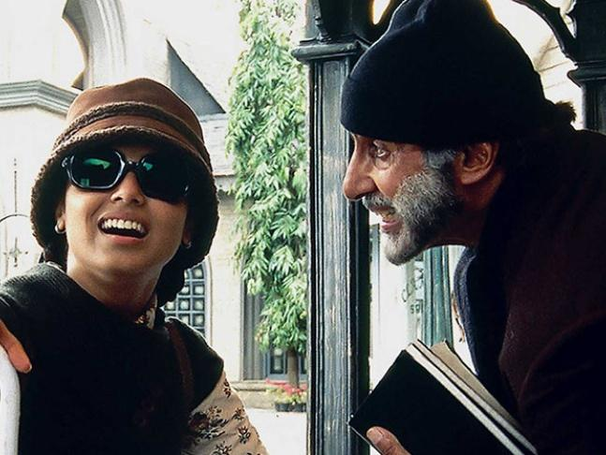



LONG TERM MEMORY
Recall
Consistent word usage
Application of learned skills

Slide 27
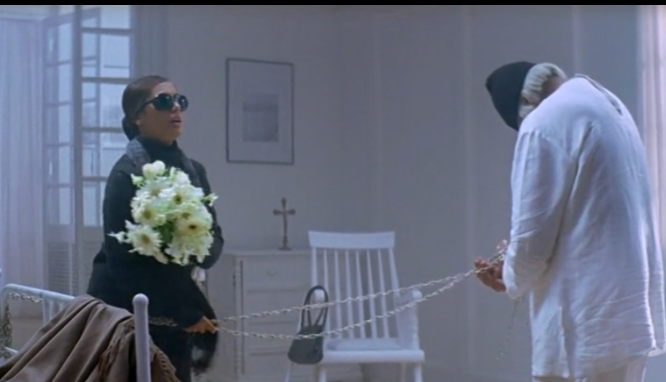
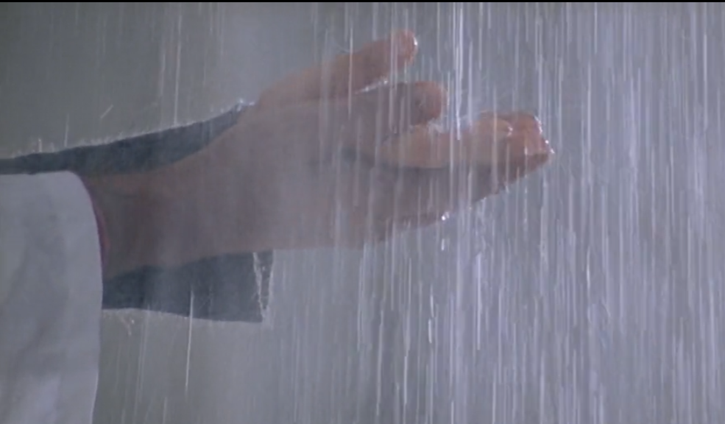
Long Term Memory
Michelle emotional connections with others contribute to the formation of enduring memories that shape her identity and experiences.
As Debraj’s Alzheimer’s progresses , his long term memory also starts to deteriorate
Towards the end ,Debraj has forgotten words , how to talk , people around him , EVEN Michelle.

Slide 28
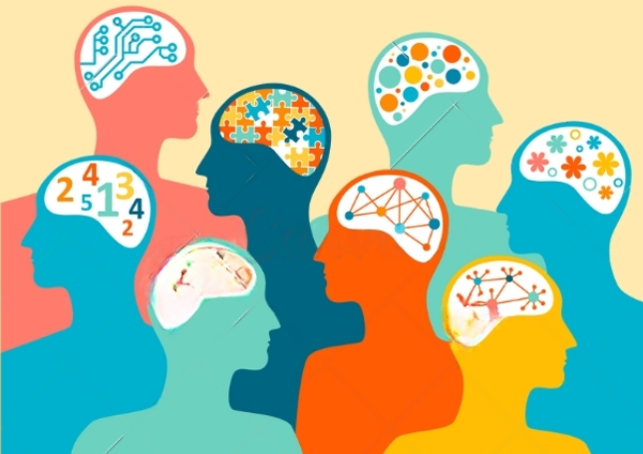
06
Perception

Slide 29
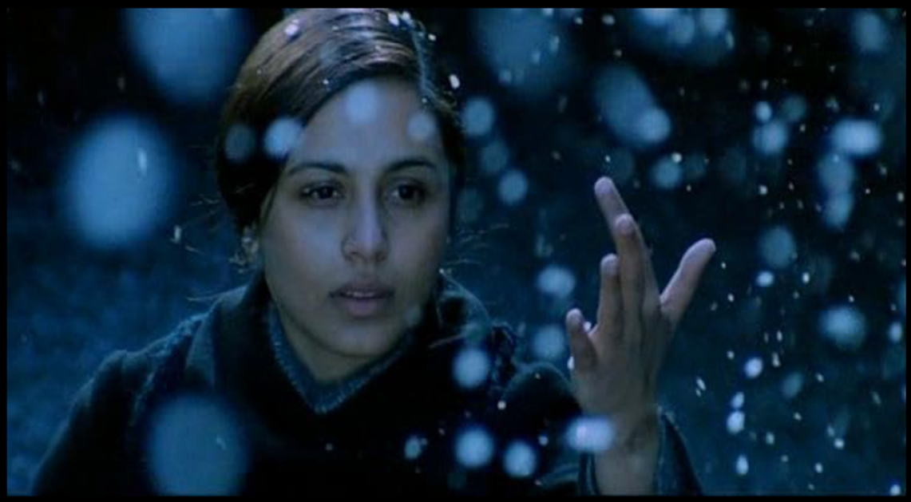
What is perception?
Perception refers to the way individuals make sense of the environmental stimulus around them.
It involves recognizing, organizing and interpreting the stimuli received through various sensory systems.
In case of Michelle perception plays a key role to develop her understanding of the world around her because she receives an inadequate amount of sensory stimuli.

Slide 30
Developing perception
Debraj would speak on her hand and make her touch the objects around her to make her understand the structure of words and most importantly associate the word with the correct object.
Debraj would also make her learn braille so that she could read & write.
He would also teach her sign language to make her communicate with people around her.

Slide 31
Use of bottom up and top down approach
Debraj strengthened her bottom up approach by making her feel the objects around her.
He also strengthened her top down approach by making her associate the words with the objects and give context.
This shows that even though she relied on only her touch alone as sensory input Michelle excelled in her life and became a college graduate.

Slide 32
Thank You!
We hope you take something away from this movie and understand that no matter how hard or how impossible something might seem, if one wills to do something, there is no force that can stop them

